Slide 1
Restaurant Ready
Eric Hall | Sam Buttonow | Rizik Haddad

Slide 2
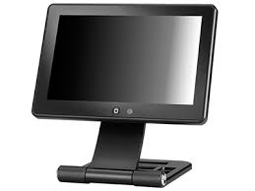
About our project
What is it?
Restaurant Ready is a “point-of-sale” system: a locally networked software solution for restaurant business operations.
What does it do?
Enables waitstaff to construct customer orders and perform payment actions.
Kitchen workers receive new orders from the same system.
How do you use it?
Log-in access terminals are distributed throughout the building.
Full system control computer typically located in nearby office.

Slide 3
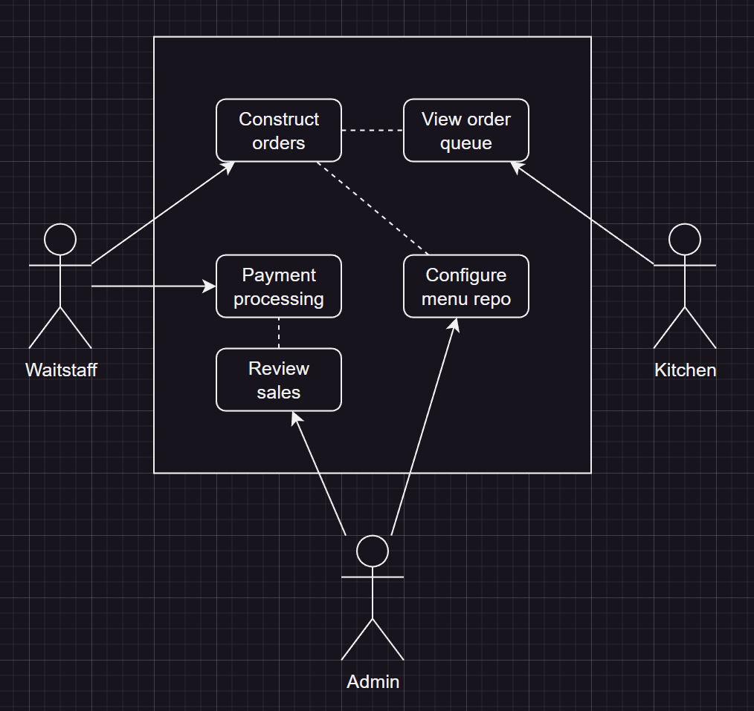
Simple is better
Our front-of-house customer order entry interface should be flexible, fast, and intuitive to use.
Our back-of-house order fulfillment system should be as simple as possible for the kitchen to perform other duties.
Our administrative tools should allow for quick menu, pricing, and inventory configuration, as well as employee profile management.

Slide 4
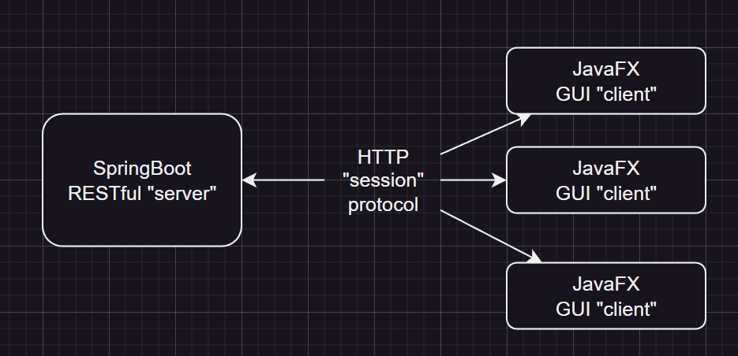
The plan
SpringBoot back-end with JavaFX front-ends (standalone desktop apps).
SpringBoot server manages all open tickets, order dispatching, and CRUD jobs.
JavaFX clients establish session protocol (heartbeat implementation) with SpringBoot server on app startup.
Client-side GUI is log-in based supporting all user types.
Page navigation will be fast to support multiple cashier profiles simultaneously.

Slide 5
User Features: Admin
Manage user (employee) profiles. Update passwords, review timesheets, etc.
Tool to configure the menu repository. Menus are containers for menu items, so multiple menus may be swapped in: seasonal, breakfast, lunch, dinner, etc.
“Birds-eye” view of all active tickets dispatched to back-of-house terminals.
Ability to “void” or “forgive” items on tickets with outstanding balances.

Slide 6
User Features: Cashier Terminal
Clock-in and clock-out. While clocked in, main menu displays cashier workspace selector.
Ability to open new tickets and construct customer orders from the pre-defined menu repository.
Ability to perform transactions via 3rd party payment processing system implementations.
Tickets may be “closed” when all outstanding balances are satistified.

Slide 7
User Features: Kitchen Terminal
Very limited feature set by design.
Simple list view of incoming orders with timestamps and itemized products.
Course breaks may be marked as “waiting”, “in-progress”, “ready”, or “complete”. Later, this can be reflected in the cashier terminal.
Completed orders are removed from the order queue.

